Slide 1
UGAthens
Transit
Eleanor Madderra, Keerthana Ramesh, Isra Naweed, Anjali Devarapalli, Ryan Majd, Shreyan Bose

Slide 2
I
What is UGAthens?

Slide 3
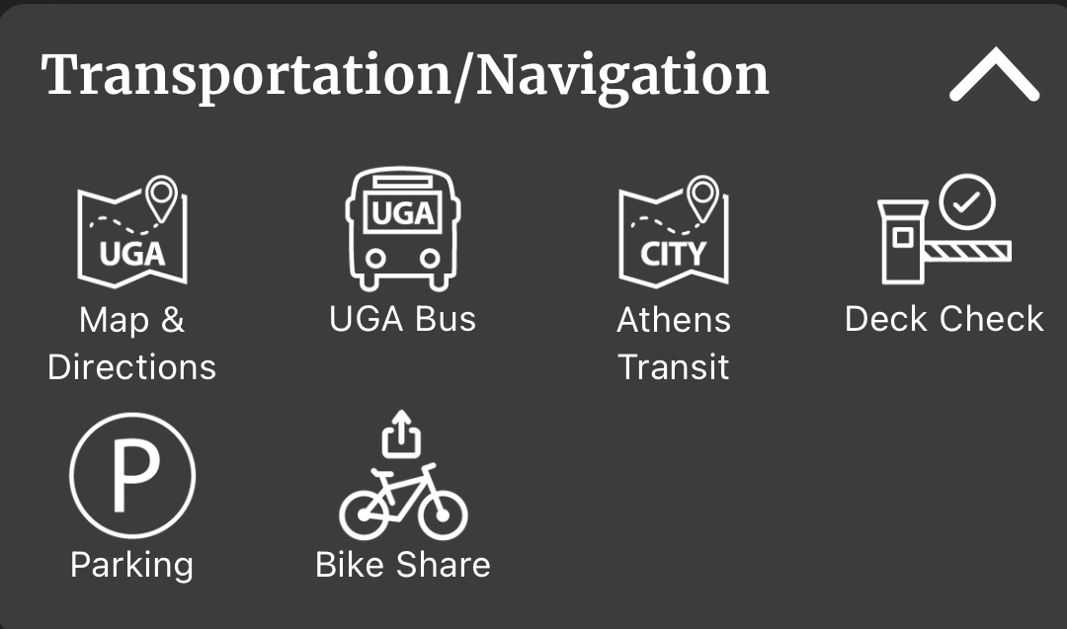
Our Problem
Navigating public transportation can be difficult and intimidating
Especially for those who are new to using public transportation
The UGA app currently has a section where users can view both UGA and Athens Transit data, but not at the same time
Users often have to check both sources to find their most efficient route
Switching between the two systems can be confusing and frustrating for users

Slide 4
Our Goal
Encourage those who live in Athens to use public transportation by making it easy to navigate
Create a website that enables UGA students, Athens residents, and Athens visitors to view a consolidated list UGA and Athens Transit bus routes, stops, and live bus tracking
Specifically:
Users are able to select a route and see all stops on that route as well as active buses
Users are able to select a stop and see all routes that stop there
Includes both UGA and Athens buses
Users are able to create an account and save favorite routes and stops
Will be able to filter by favorites

Slide 5
II
Project Plan

Slide 6
Our Responsibilities
Project Manager Ryan Majd | Identify and assign tasks as needed Monitors process of team and keeps everyone on track Helps in different areas of the project as needed
Architect/Documentor Eleanor Madderra | Maintains and update the GitHub Repository and Project page Keeps up with documentation including the project plan, software design document, and the software requirements specification
Website Tester Shreyan Bose | Document test plans and test results, checking for ways users may accidently or maliciously abuse different aspects of the website Ensure that the website shows accurate, easily readable information
Web Designer(s) Isra Naweed Keke Ramesh | Determines the overall look and feel of the website Keeps in mind user need while designing Ensures easy usability
Back End Developer(s) Anjali Devarapalli Keke Ramesh Isra Naweed | Build the backend Scrape the Athens and UGA Transit websites and combine route information Create a working map with live bus tracking
Notes:
all

Slide 7
Organizational Structure
We operate under a hierarchical structure
Responsibilities are assigned
Manager makes sure we stay on track
Reassign responsibilities when necessary
Project Manager
Architect/
Documenter
Web Designer
Back End Developer
Website Tester
Notes:
eleanor

Slide 8
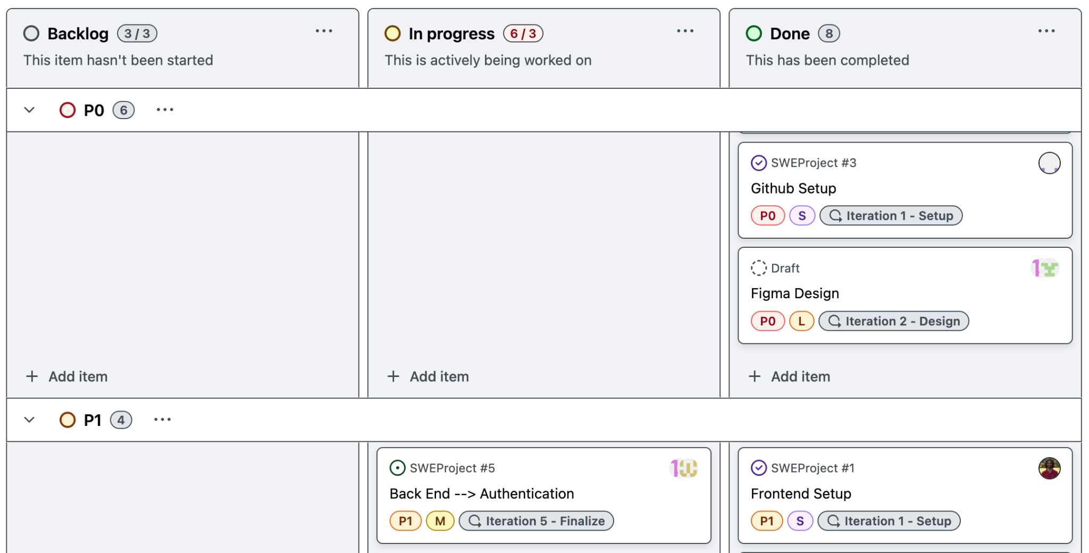
Our Tools
GitHub Repository
Version control tool
Centralized location for our files
GitHub Projects
Keep track of individual and team assignments
Stay on schedule
Easy to view each of our planned iterations
Notes:
eleanor

Slide 9
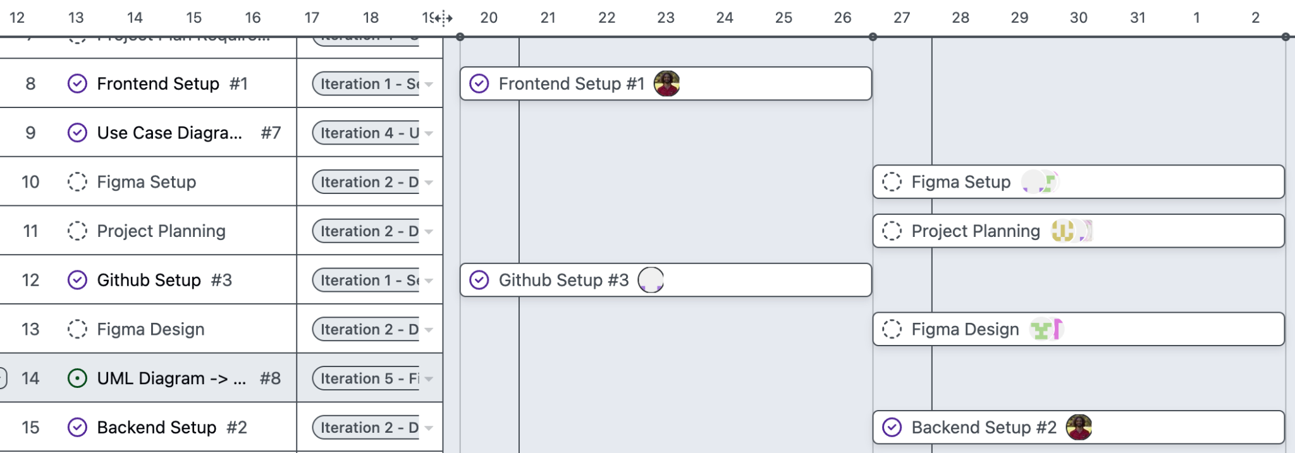
Our Roadmap
Notes:
eleanor

Slide 10
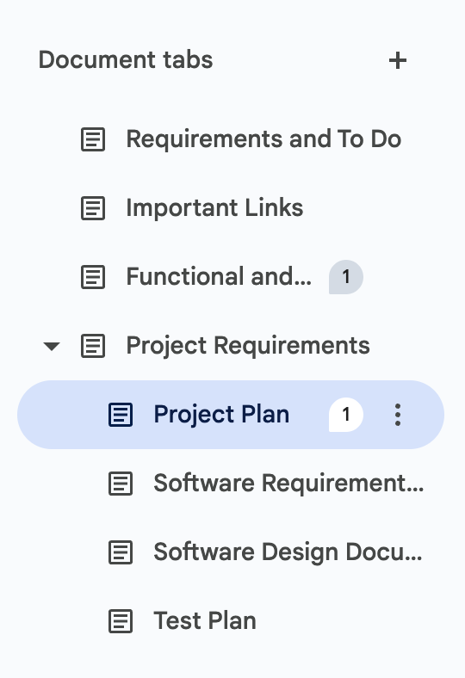
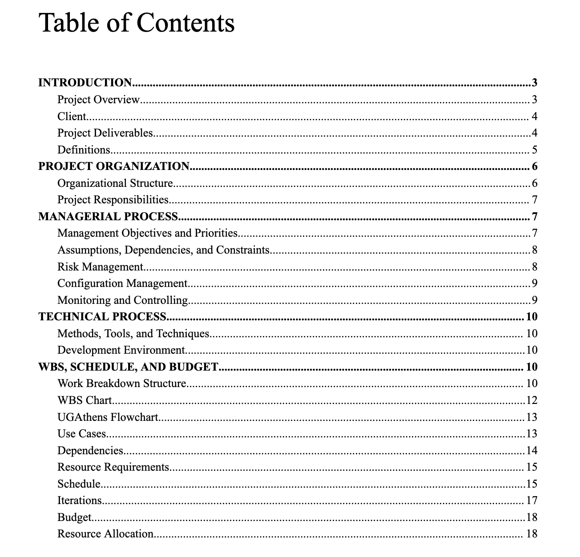
Our Tools (cont.)
Google Docs:
Documentation
Good for collaboration and sharing
Tab feature
Allowed us to work on and view multiple documents in the same place
Table of contents
Hyperlinked
Notes:
eleanor

Slide 11
III
Requirements

Slide 12
Functional and Nonfunctional Requirements
Functional:
Data integration
Integrate the UGA and Athens bus data
Live updates of destination times + location
User profile
Favorite routes and stops(TBD)
Users can easily access their commonly used routes and stops
Authentication
Search through bus routes and stops

Slide 13
Functional and Nonfunctional Requirements
Nonfunctional:
Usability
Interface will be user-friendly, allowing the website to be used intuitively
Will have a responsive design, allowing it to be easily used on both desktop and mobile devices
Security
Store account information in a secure way
Javascript

Slide 14
Use Cases
Use Case: | Sorting Through Bus Stops
Actors: | Guest Users and Users
Description: | This use case begins when an individual visits the website. The user can be a guest user or a user with an account. The user will be able to sort through different bus stops of both UGA and Athens Transit systems. If a bus stop is selected, the website will display all routes that stop at that particular bus stop.
Use Case: | Sorting Through Bus Routes
Actors: | Guest Users and Users
Description: | This use case begins when an individual visits the website. The user can be a guest user or a user with an account. The user will be able to sort through different bus routes of both UGA and Athens Transit systems. If a route is selected, the website will show all stops on that route.

Slide 15
Use Cases
Use Case: | Sorting Through Favorites
Actors: | Users
Description: | This use case begins when an individual logs into their account. The user will be able to sort through a list of all of their favorite bus stops and routes. If a route or stop is selected, it will display all stops or routes associated with it.

Slide 16
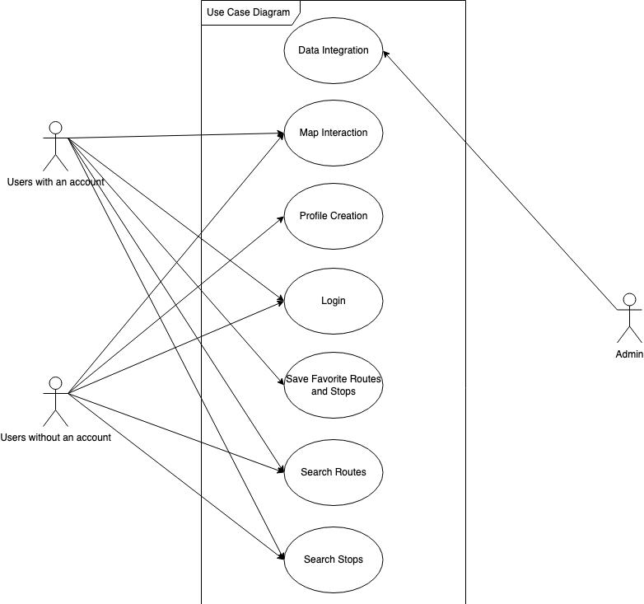
Use Case Diagram

Slide 17
Use Case Diagram

Slide 18
Use Case Diagram

Slide 19
Use Case Diagram

Slide 20
IV
Software Design

Slide 21
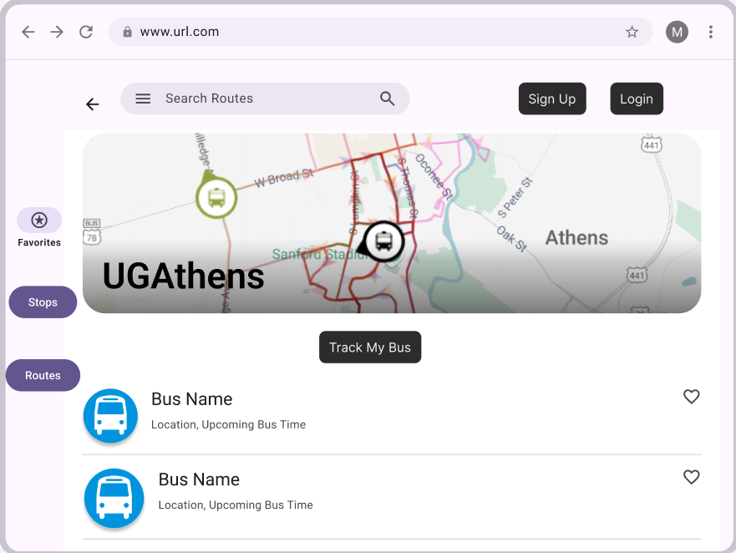
Front End
User Interface Design Created in Figma

Slide 22
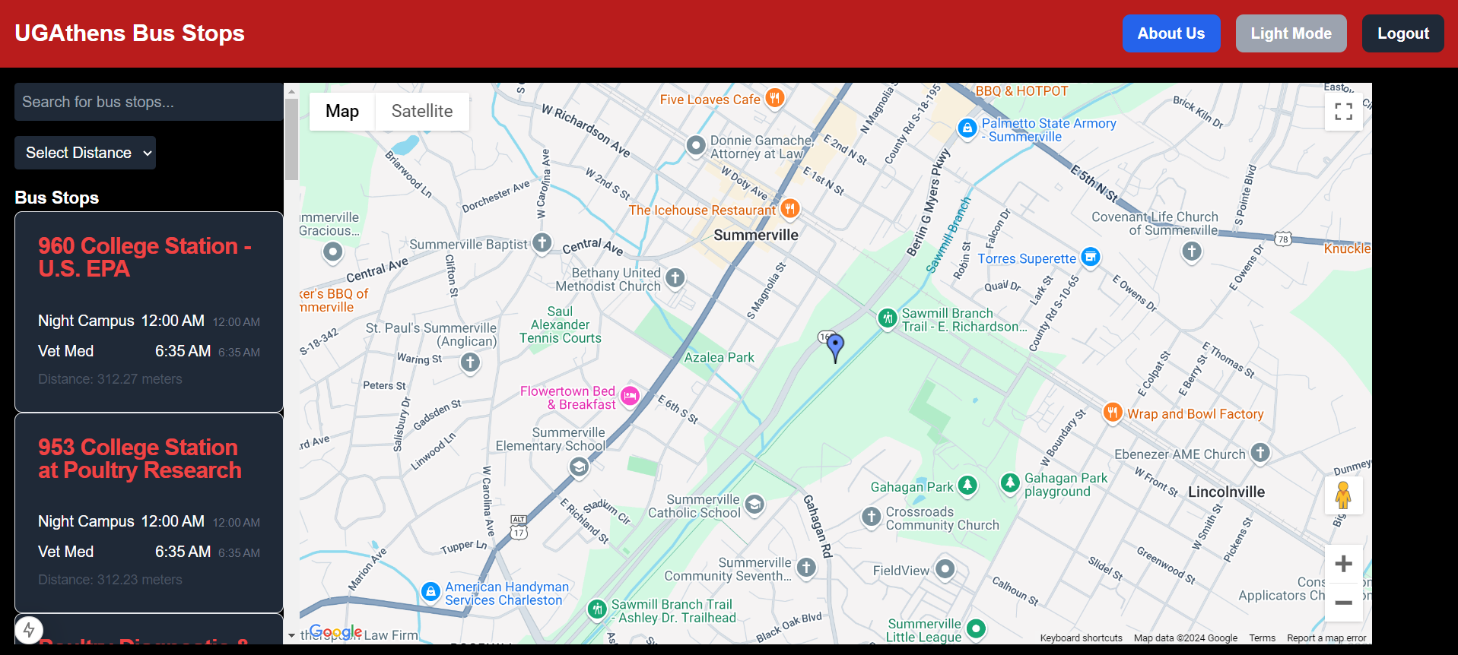
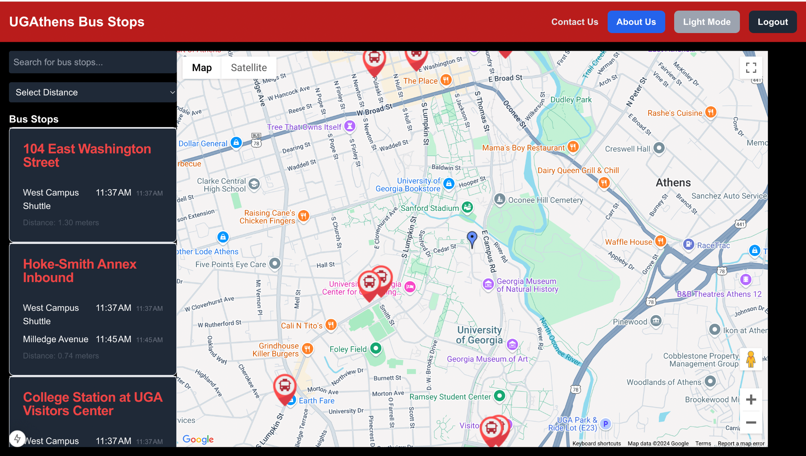
Front End

Slide 23
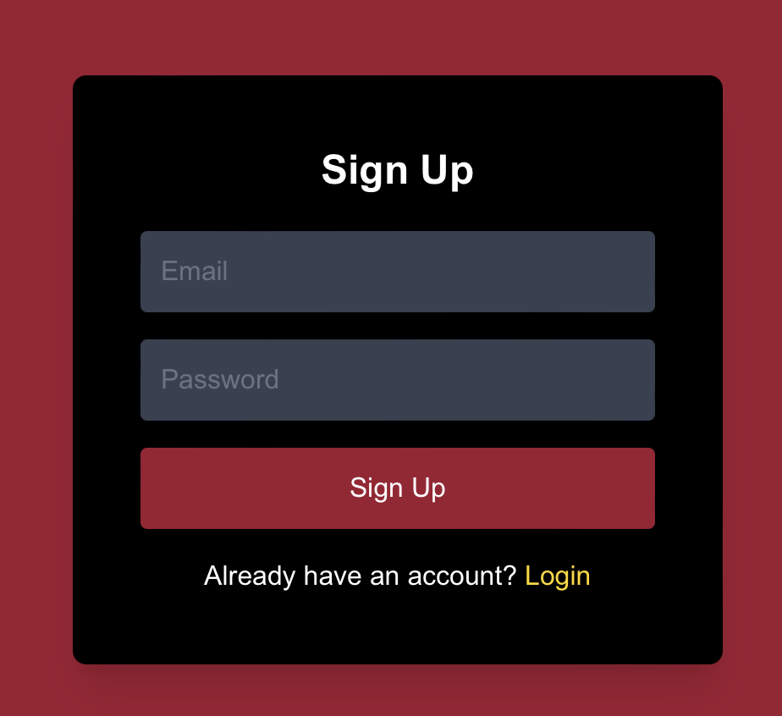
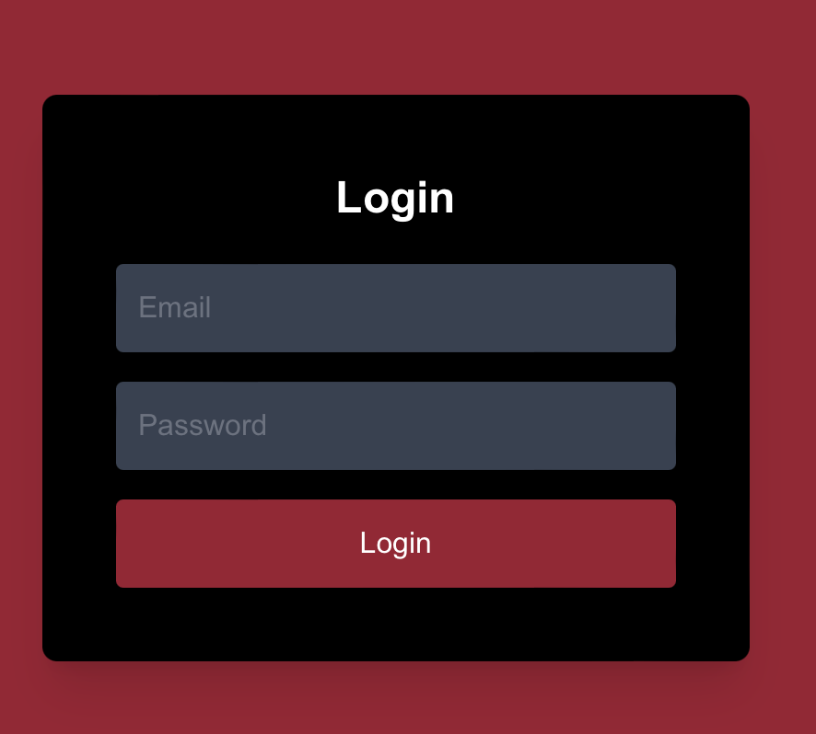
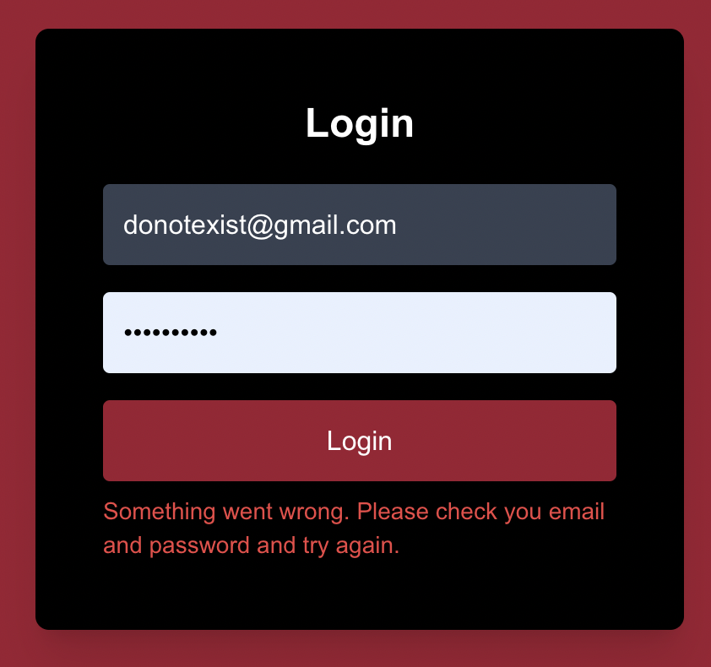
Back End- Authentication using Firebase
We used firebase for authentication to securely log users into the UGAthens website

Slide 24
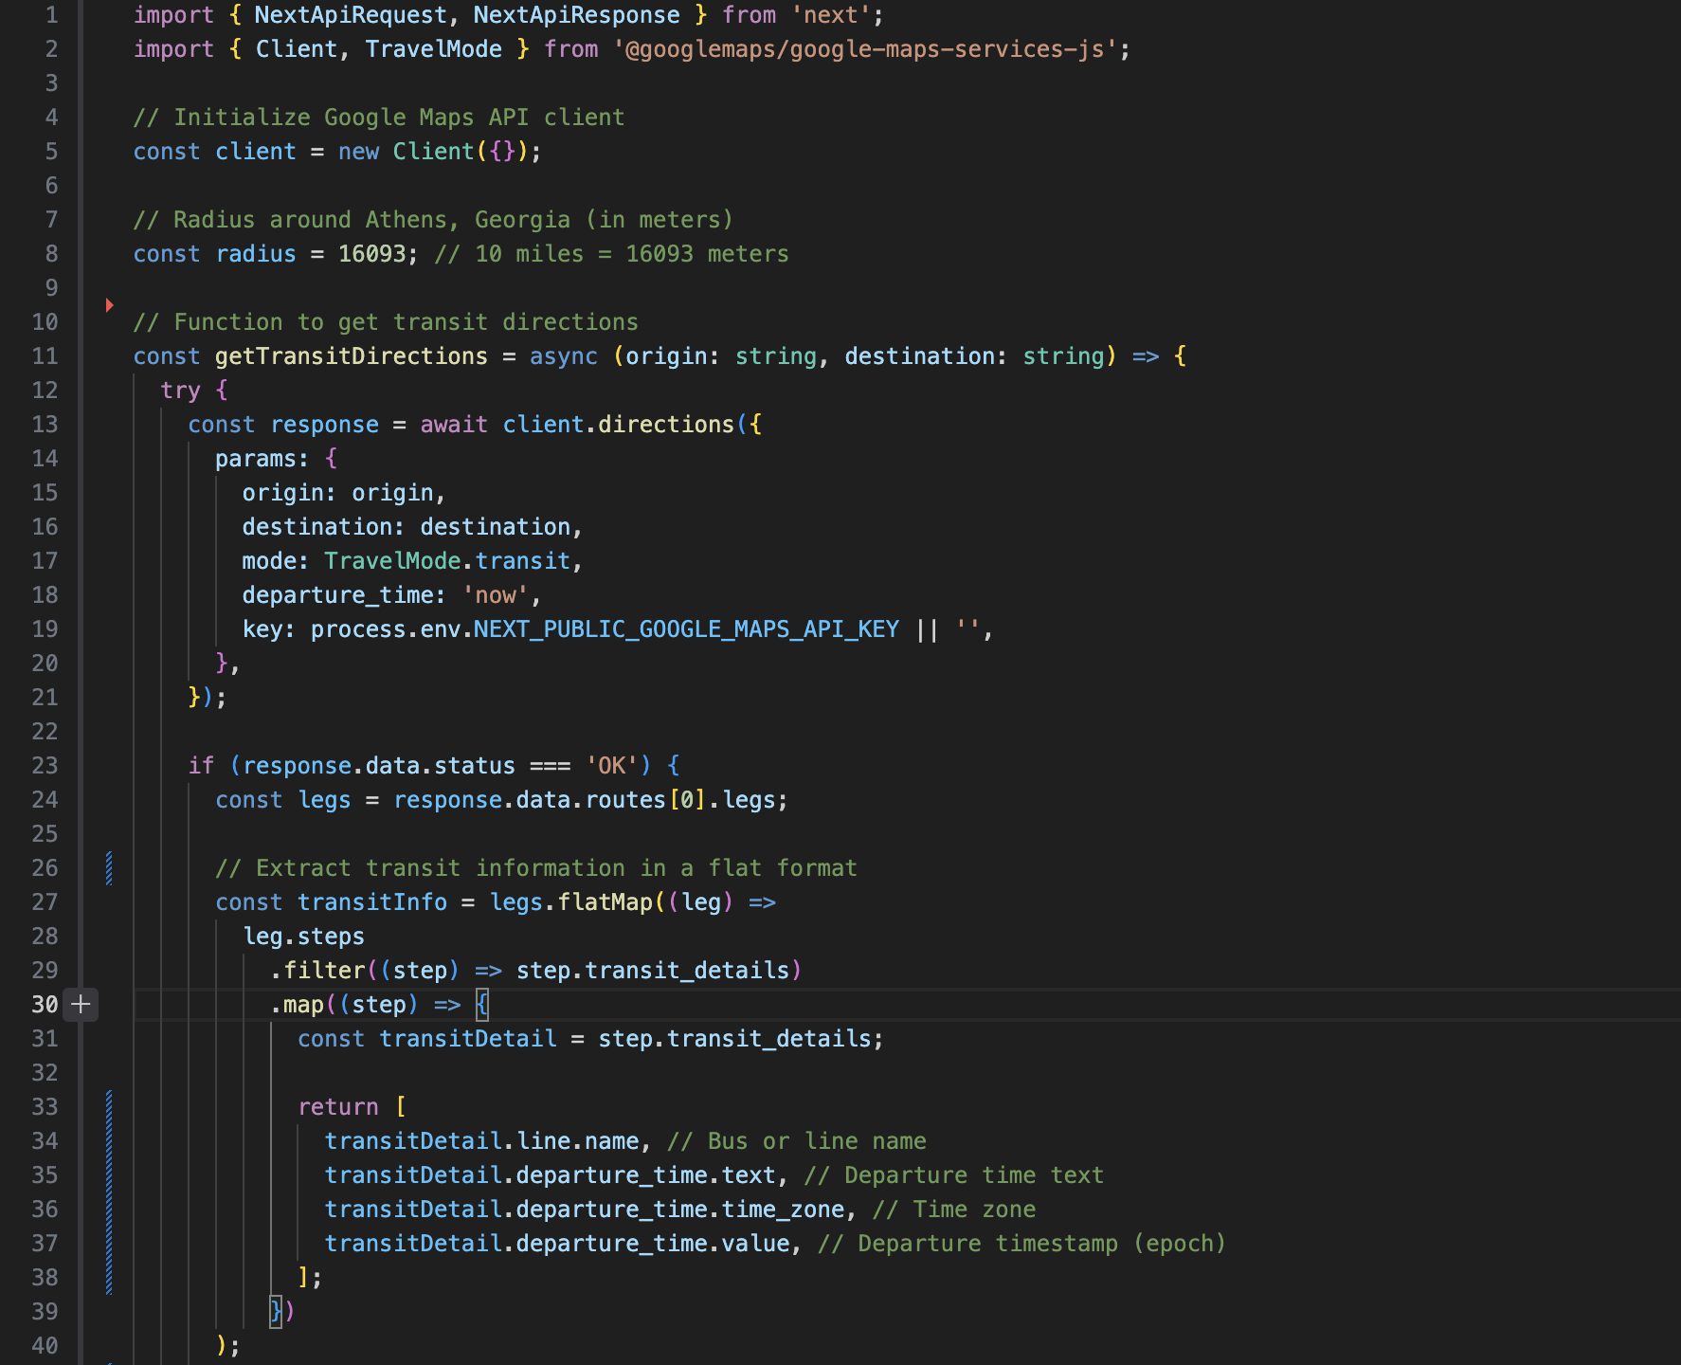
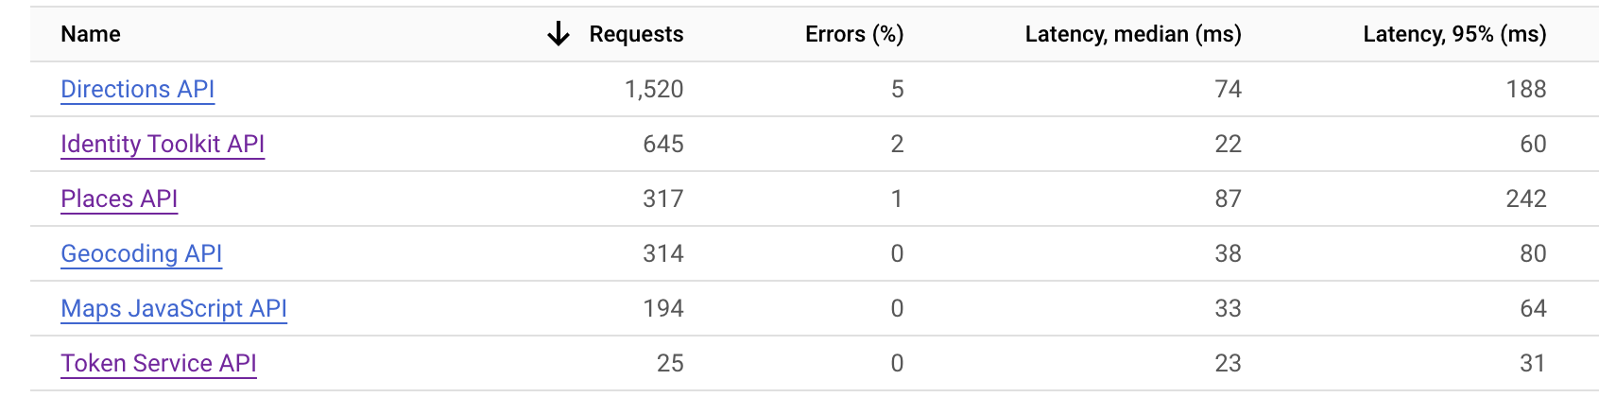
Using Google Maps API along with Google Transit within Google Maps
Utilized Google Maps API to display interactive maps and pinpoint locations relevant to our project.
Google Transit was incorporated to provide real-time transit schedules, routes, and travel times, enhancing the user experience for transportation planning.
This integration ensured accurate, dynamic navigation tailored to user needs.

Slide 25
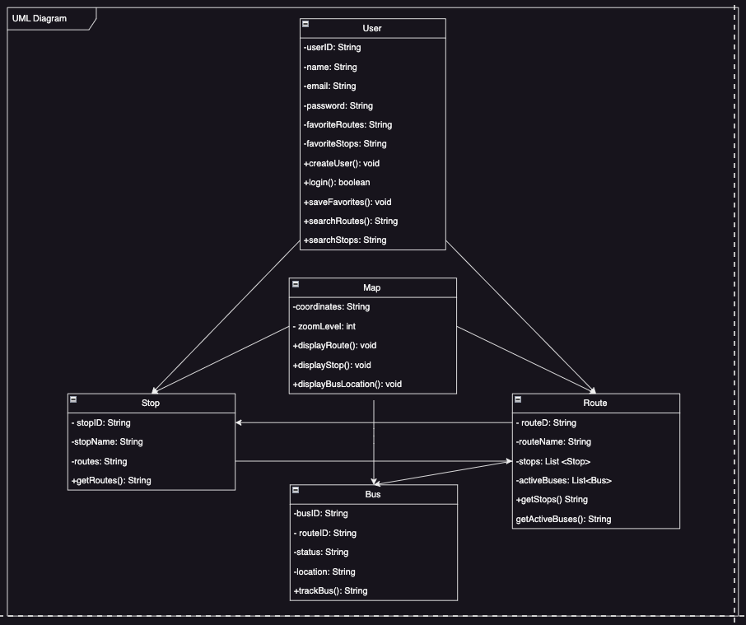
UML Diagram
This UML diagram provides a clear blueprint for the website's structure, ensuring intuitive navigation, live tracking, and user-centric features. The relationships between classes illustrate how user data, routes, stops, and live bus information are interconnected to deliver a seamless public transportation experience in Athens.

Slide 26
V
Testing

Slide 27
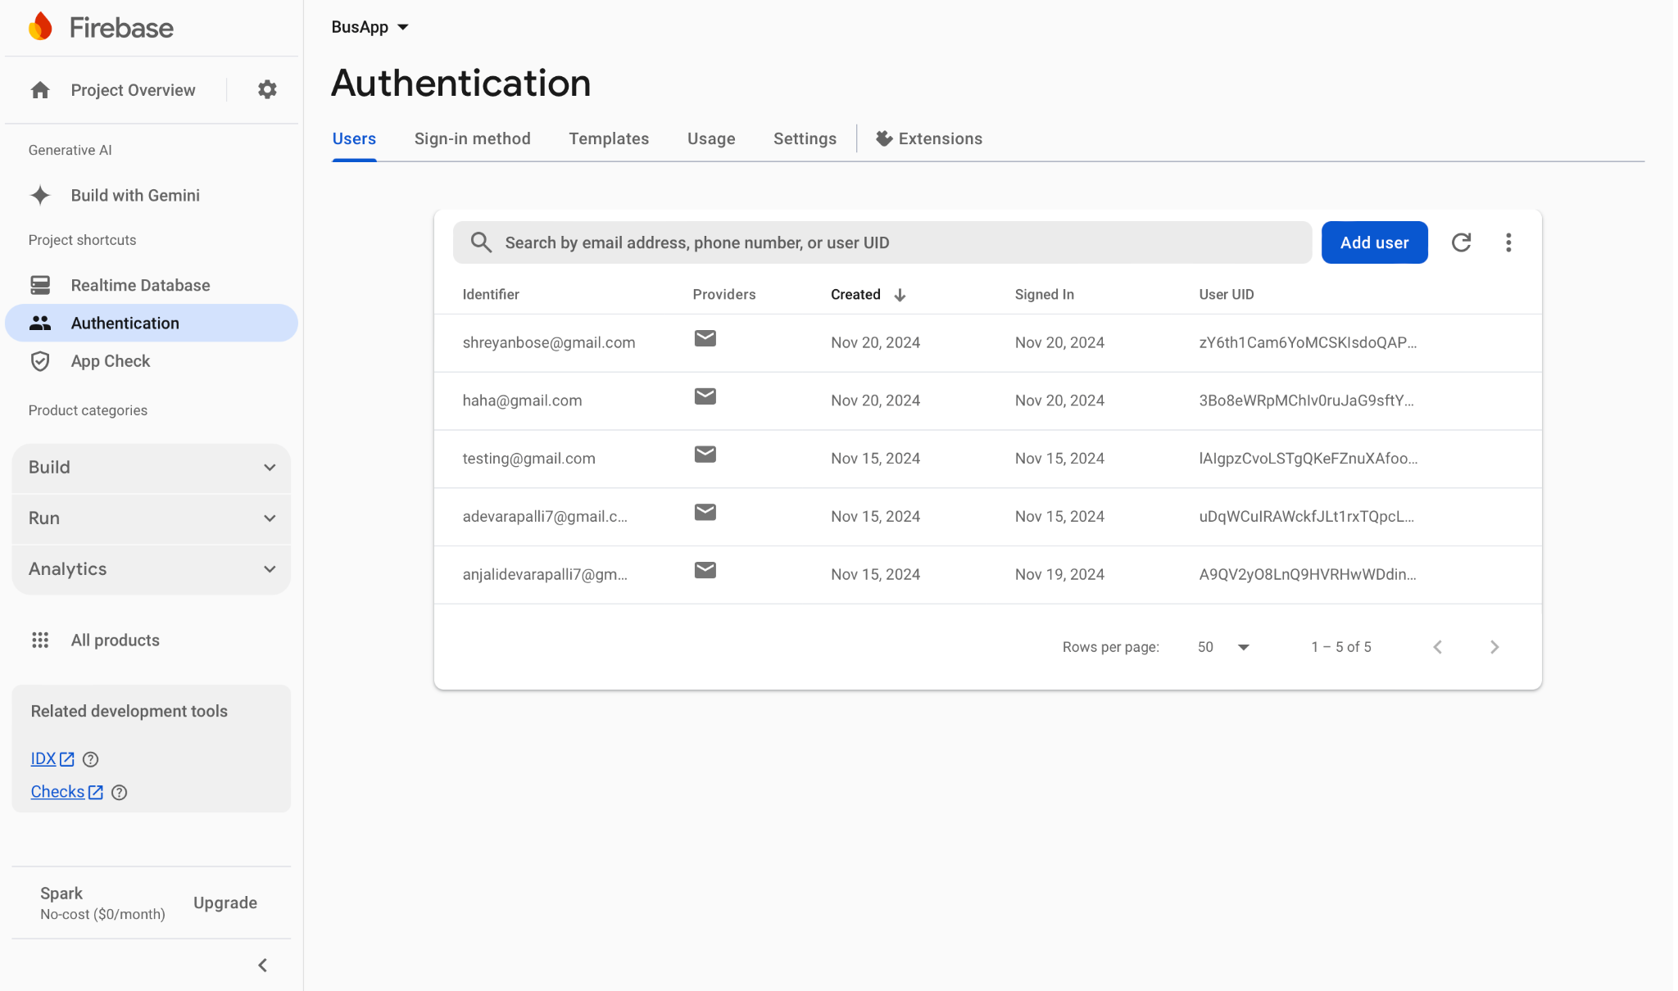
Test Cases
Here are the current registered users of our app:

Slide 28
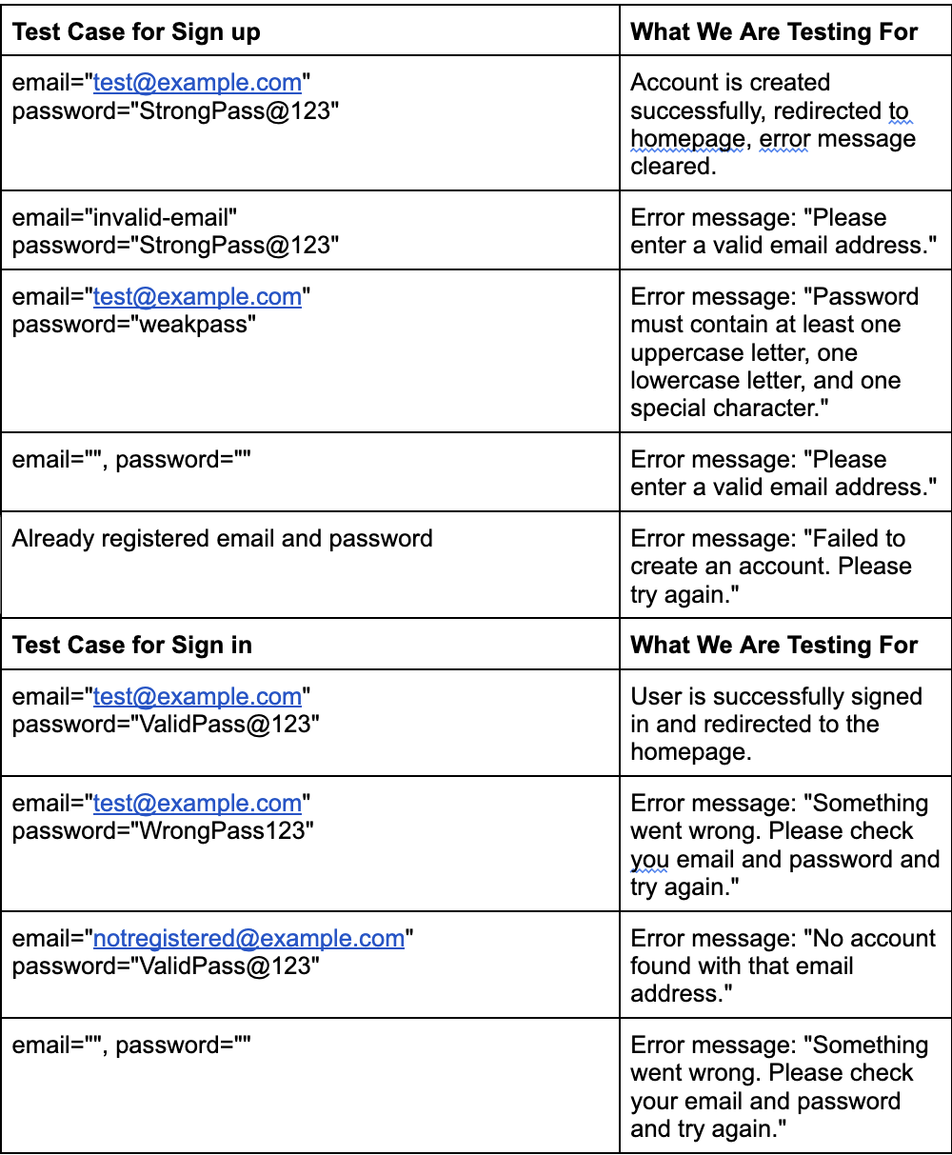
Test Cases (cont.)

Slide 29
VI
Demonstration

